Slide 1
Locating landowners & operators in a watershed
Jon Charlesworth and Leslie Davisson
2015 Indiana watershed leadership academy group project

Slide 2
Why this subject?
New RCPP (Regional Conservation Partnership Program) and MRBI (Mississippi River Basin Initiative) watershed projects
Both have a need to work with the landowners & operators, but who are they?
How do I find all these people?

Slide 3
Project Overview
Mapping your targeted watershed area.
Identifying parcel owners in your watershed.
Provide a process for finding landowner & operator information.
A few ideas to engage the group within the area.

Slide 4
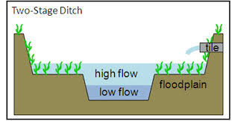
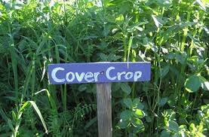
Notre Dame Two-stage Ditch with Cover Crops RCPP Project
The project comprises parts of Newton, Jasper, and Benton counties.
Need to saturate a 6000 acre watershed with two-stage ditches and cover crops over four years.
Water quality and soil health parameters are measured over time.
When implemented together, do these practices have a significant impact on water quality?
Never been studied at a watershed scale before now.
Widespread landowner/operator participation is essential to the success of the project!

Slide 5
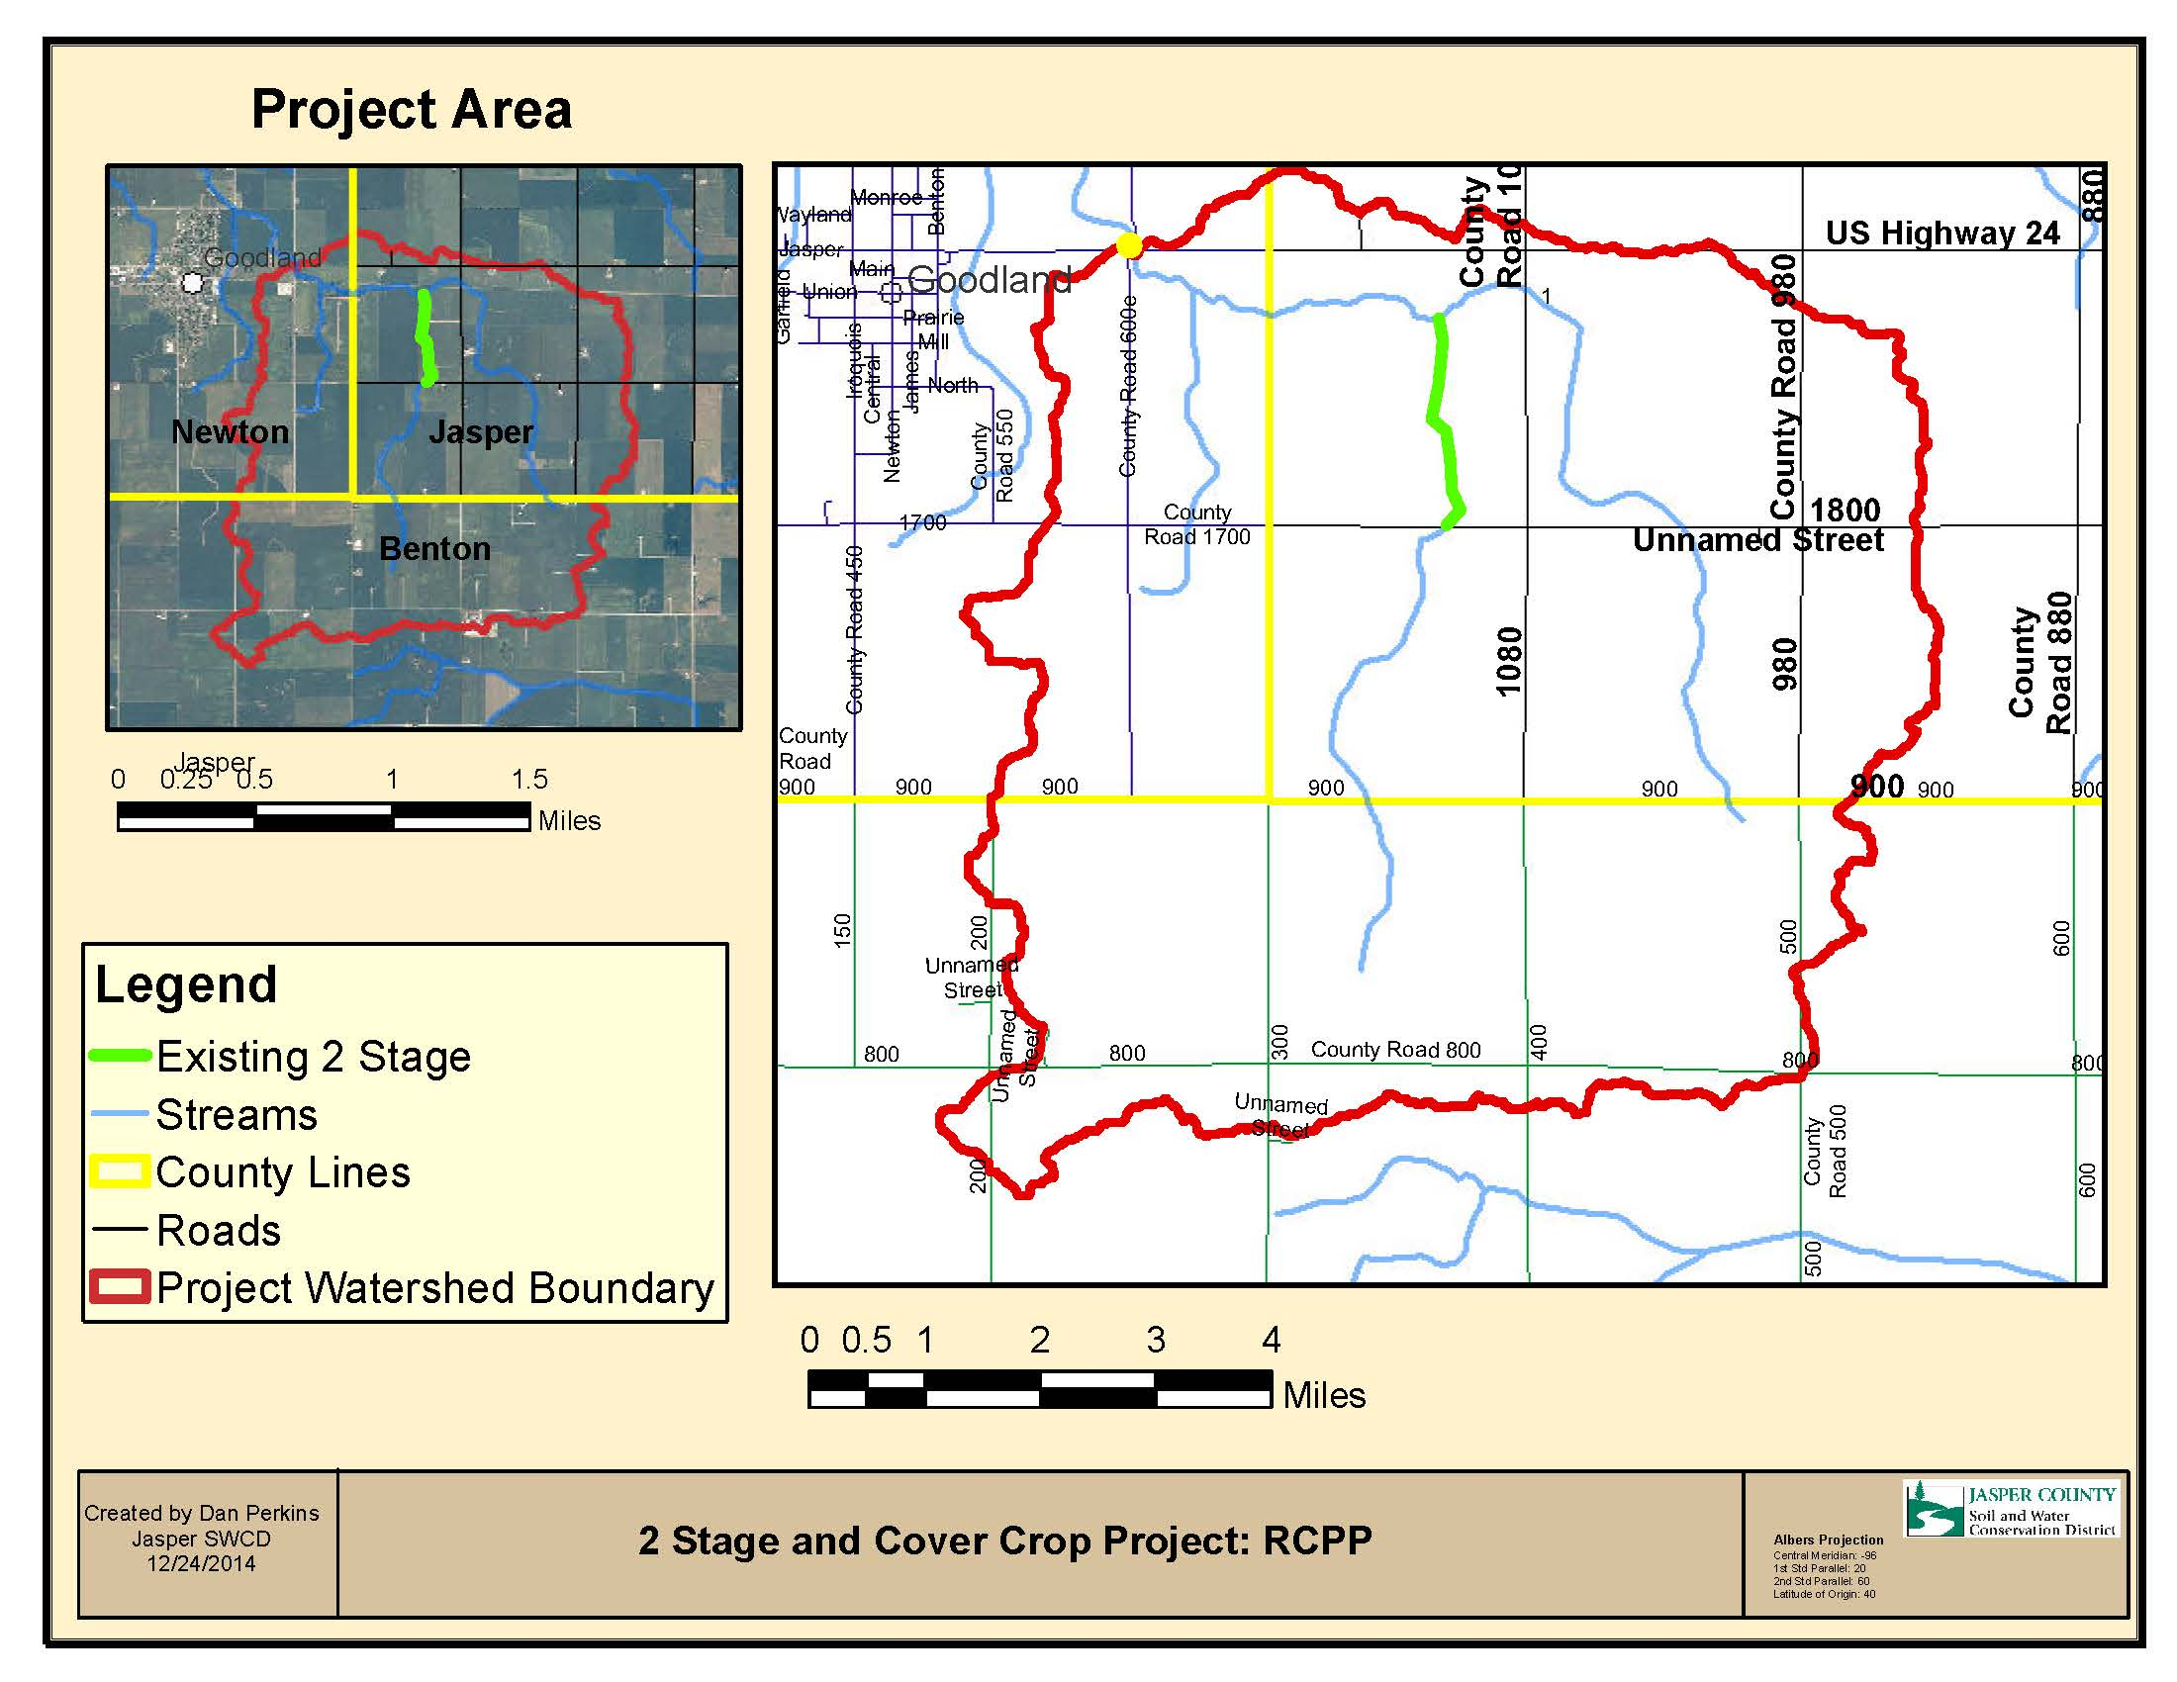

Slide 6
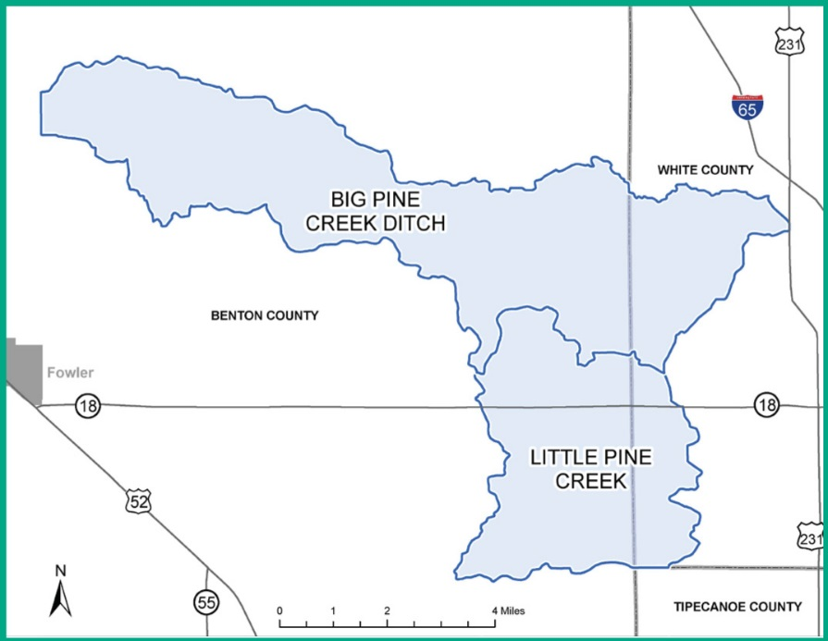
NRCS-EQIP (Environmental Quality Incentives Program) Funds Targeted to specific HUC12 subwatersheds.

Slide 7
What are the road blocks to landowner/operator information?
Lack of access to GIS software
Lack of knowledge about GIS software
No Memorandum of Understanding (MOU) with the local Farm Service Agency (FSA)
Plat books only have landowner names
Unfamiliar with the area

Slide 8
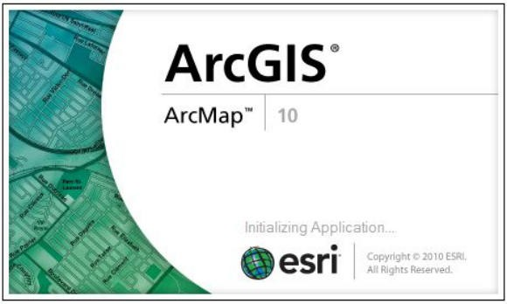
ArcMap is a great tool to map your watershed area.

Slide 9
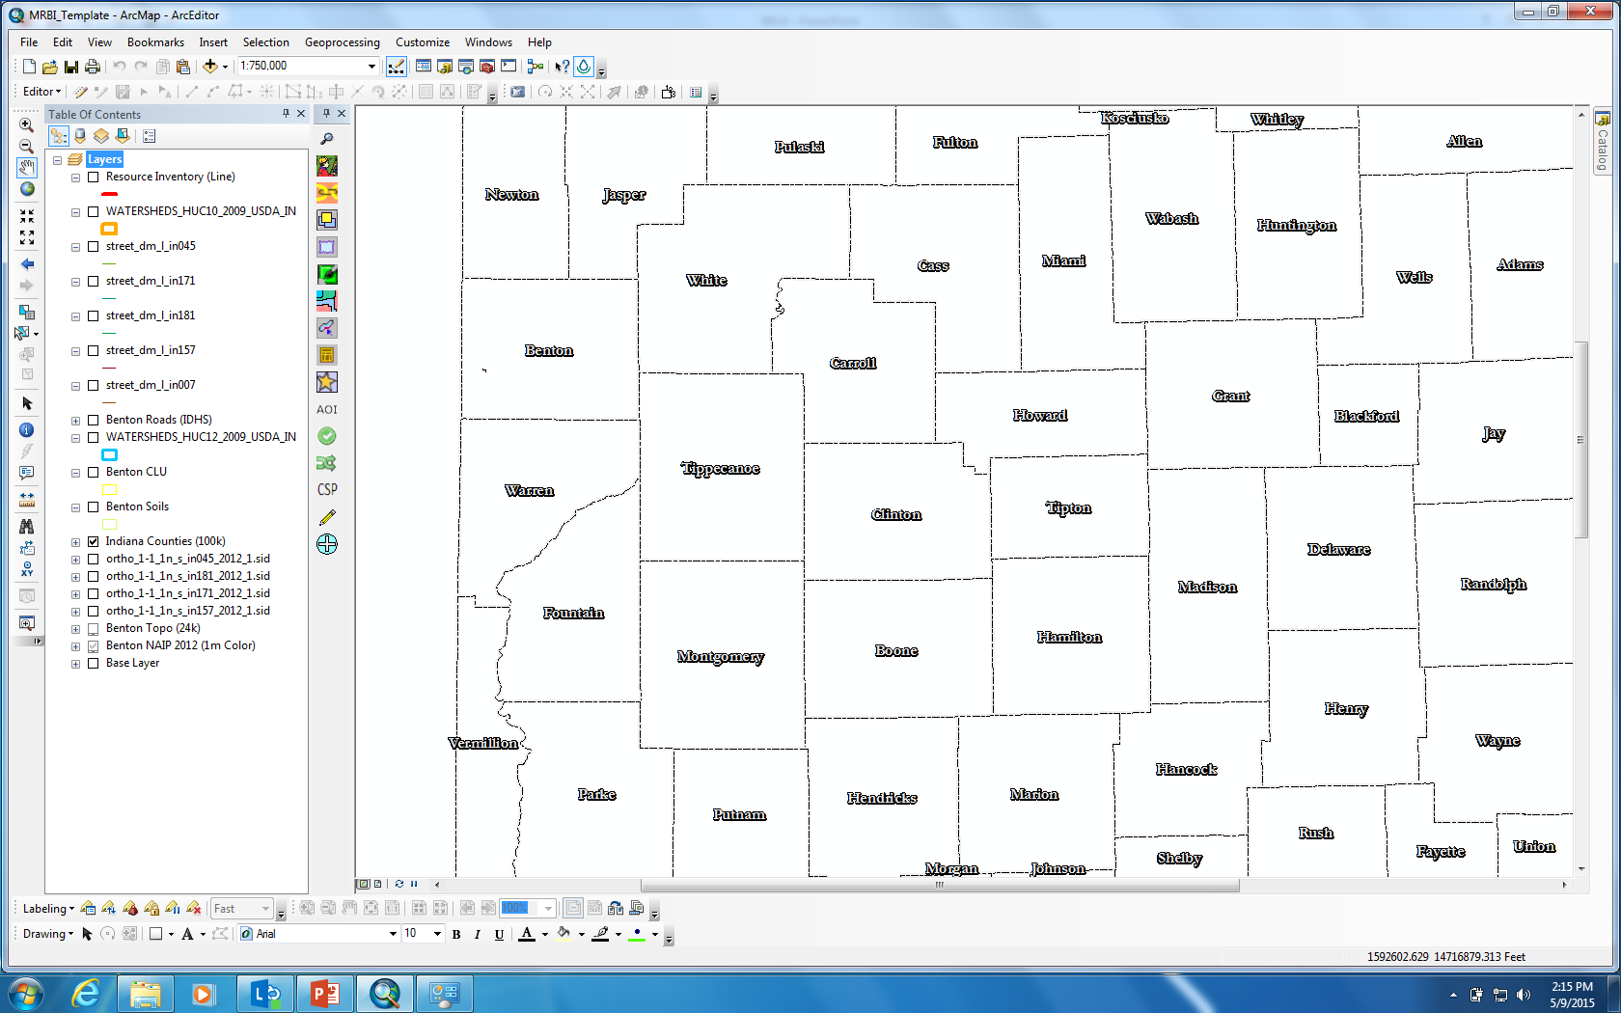

Slide 10
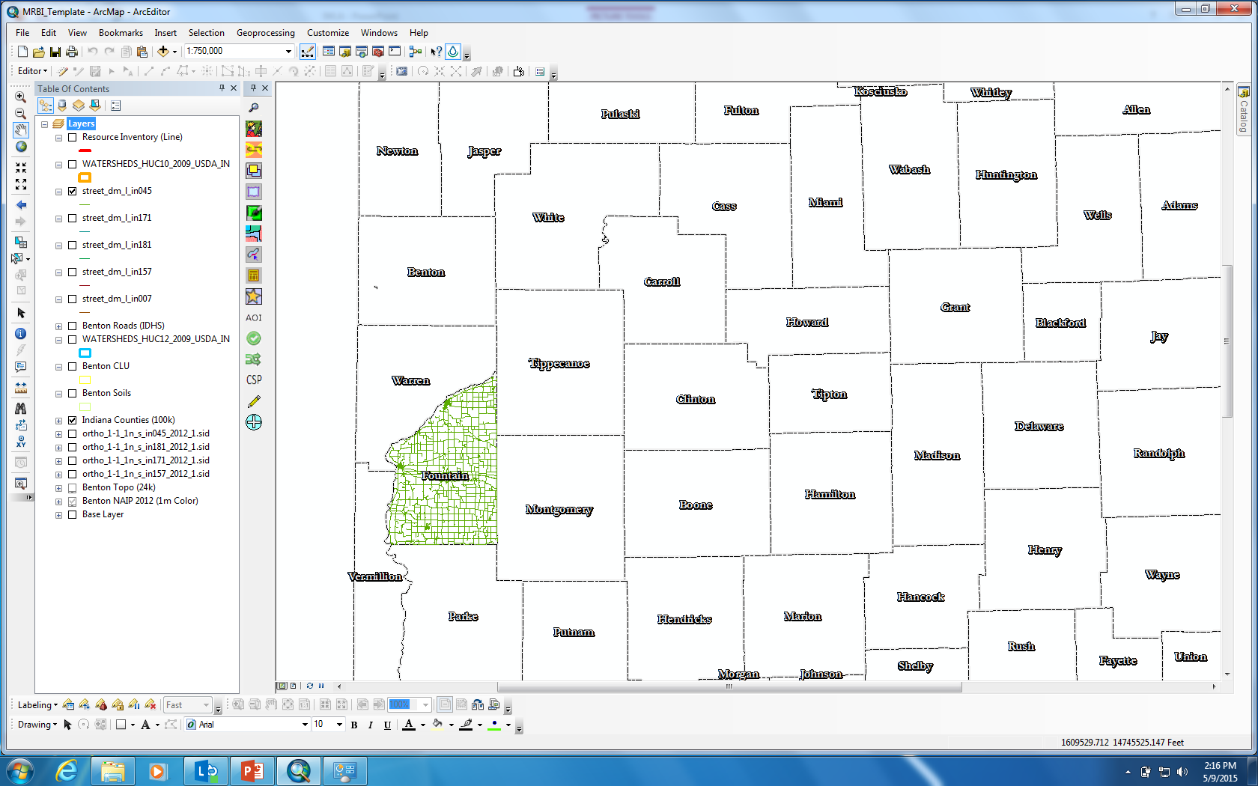

Slide 11
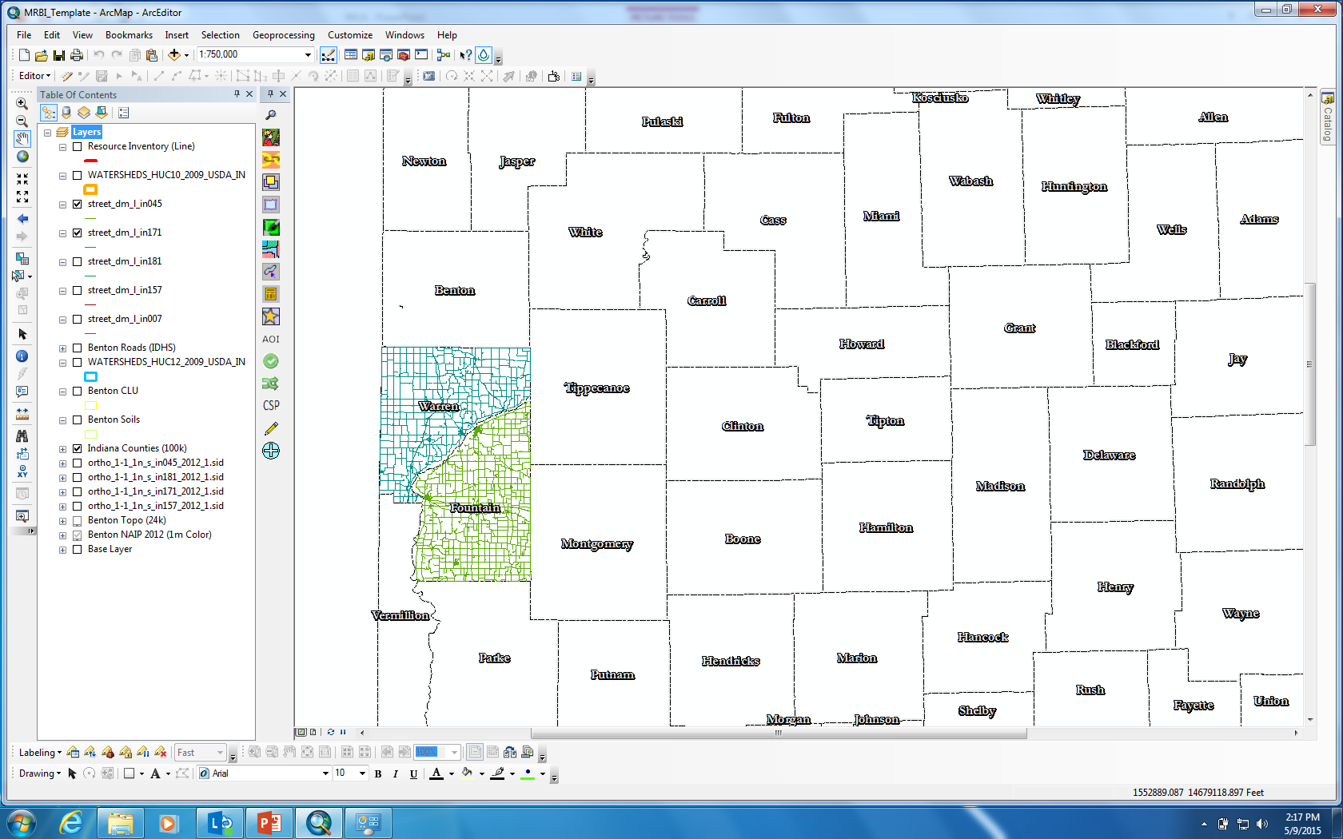

Slide 12
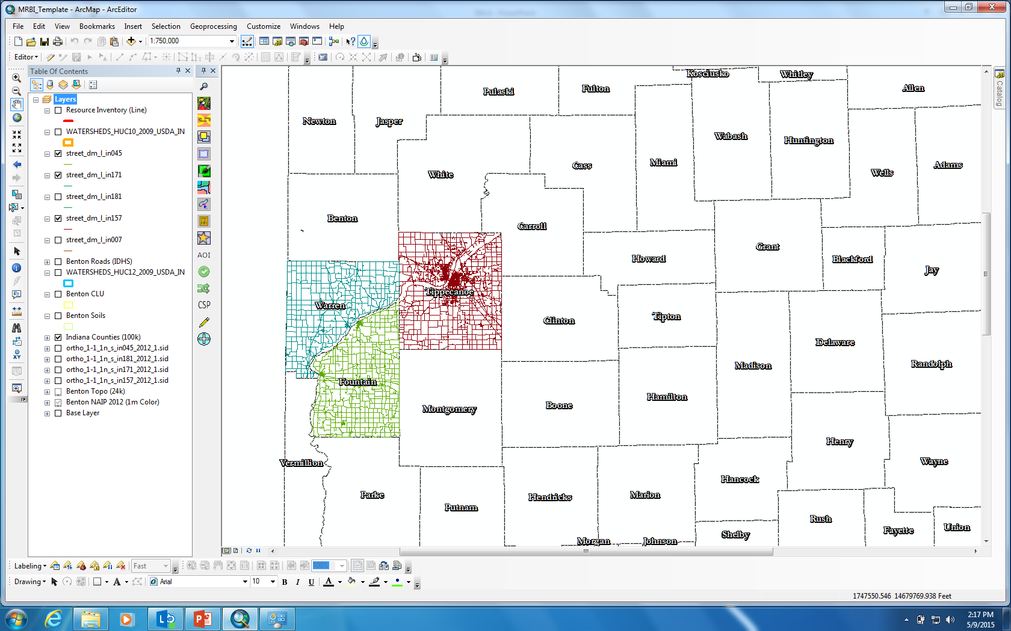

Slide 13
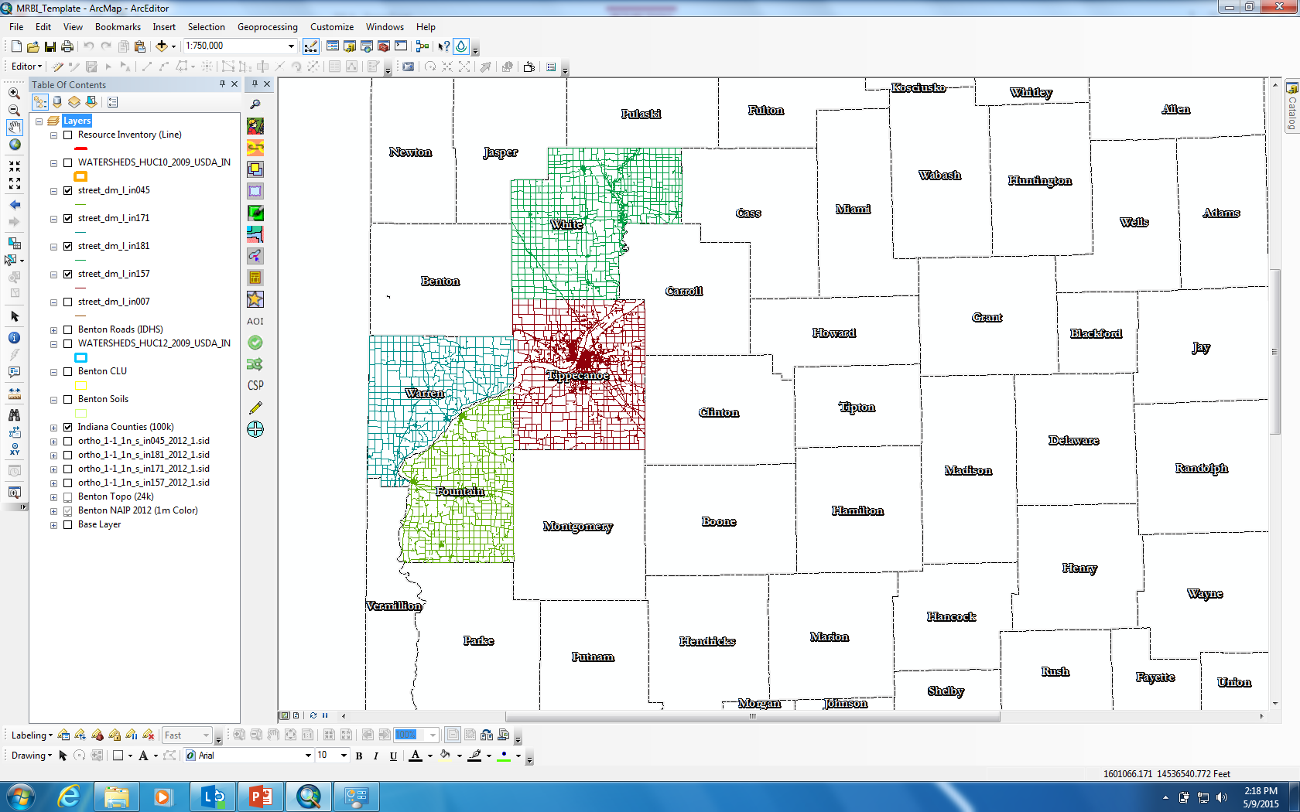

Slide 14
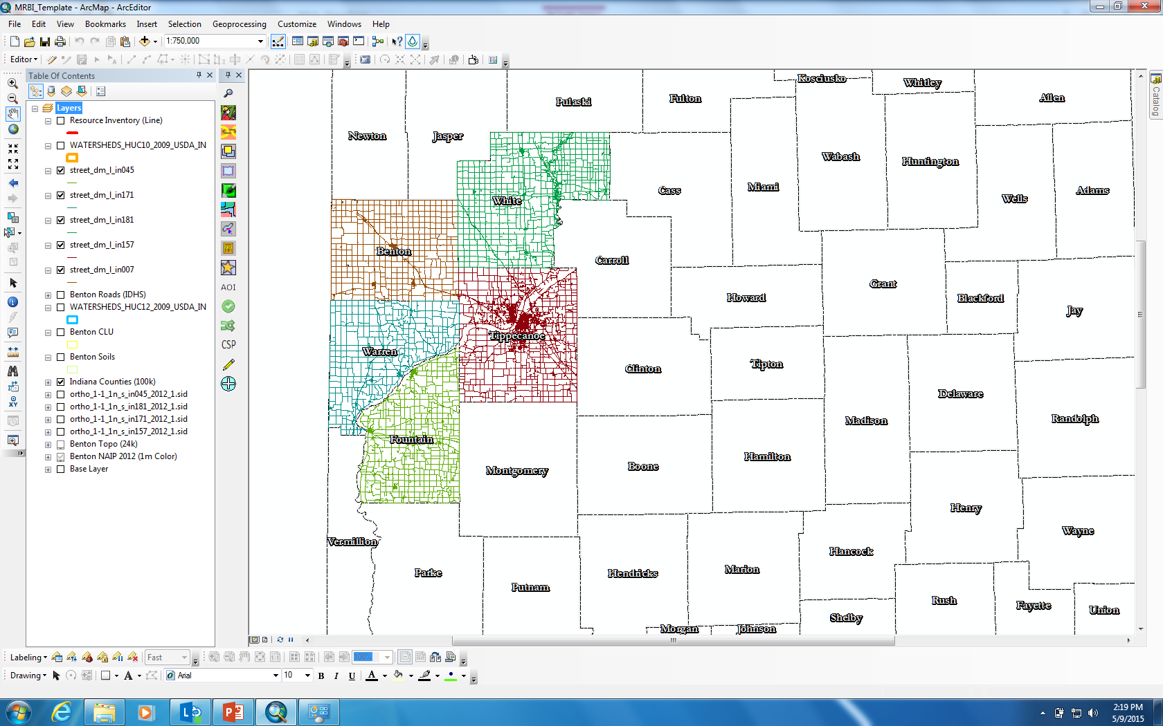

Slide 15
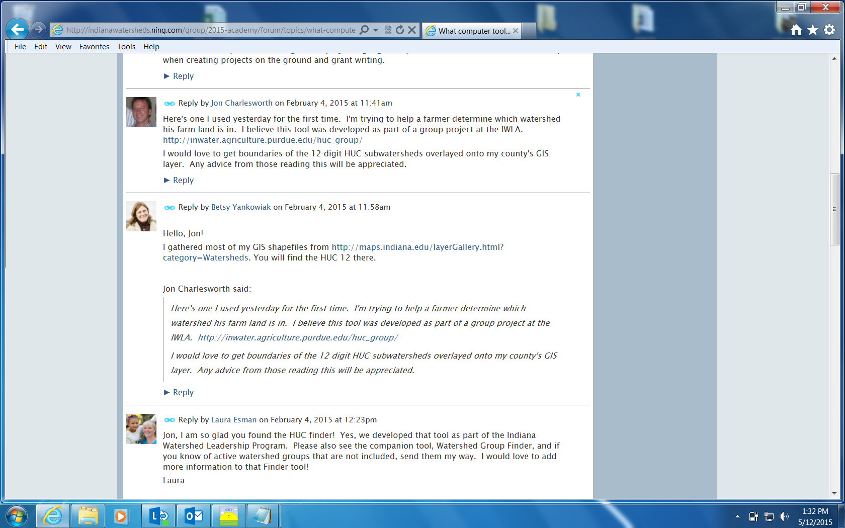

Slide 16
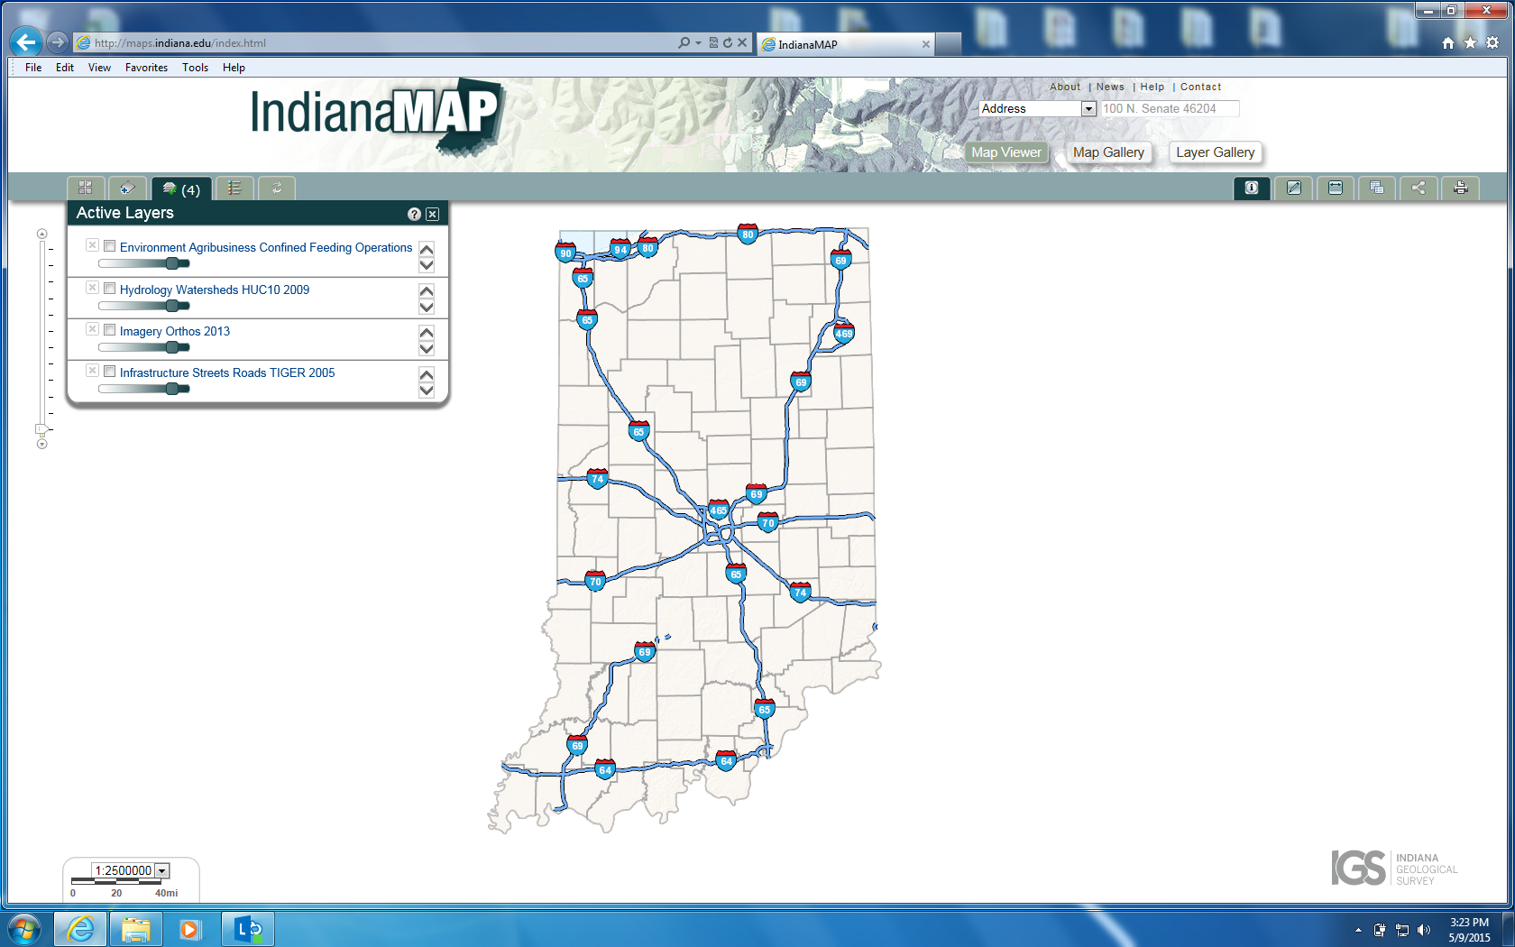

Slide 17
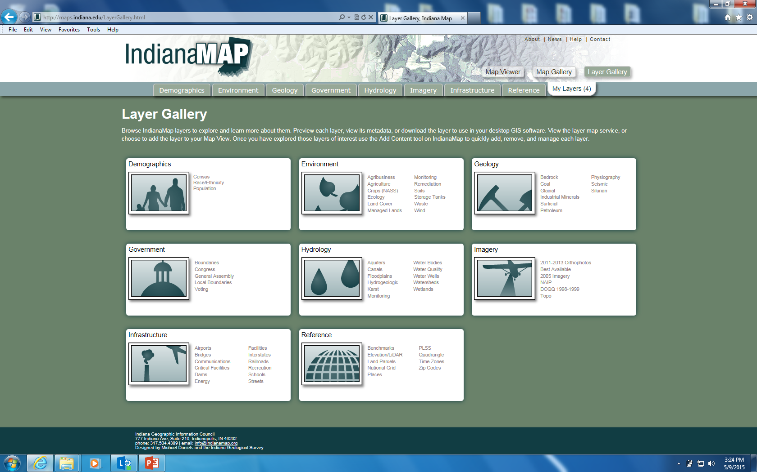

Slide 19
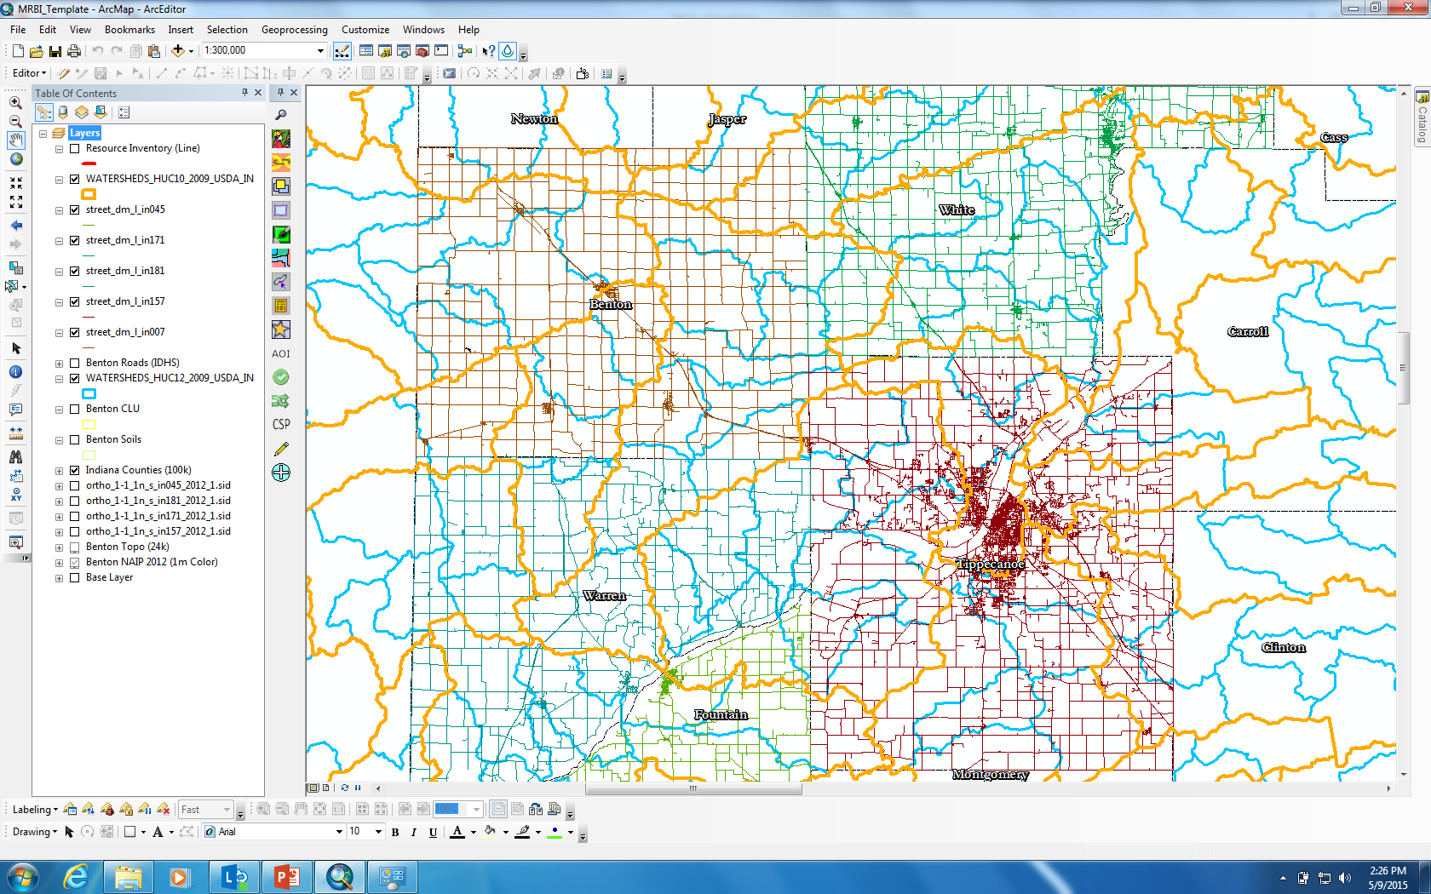

Slide 22
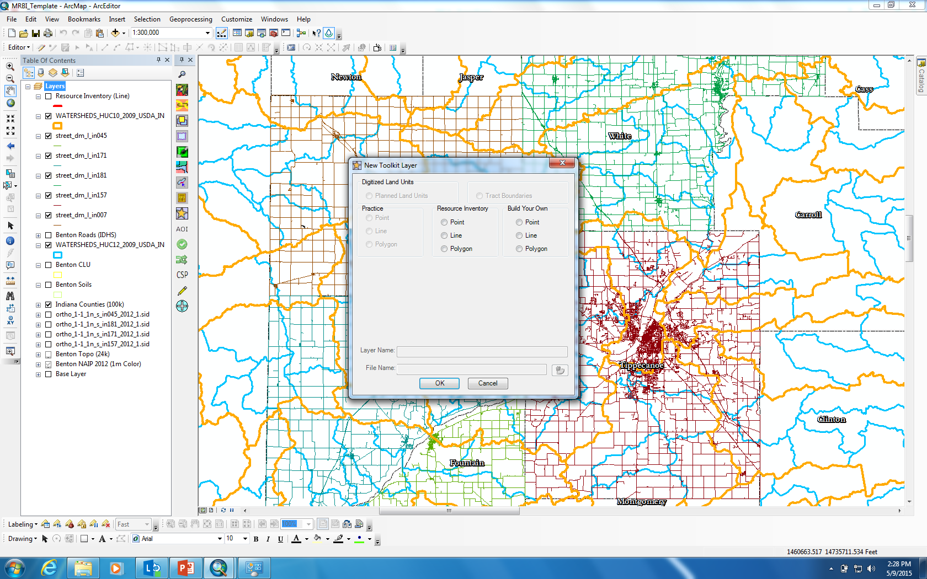

Slide 23
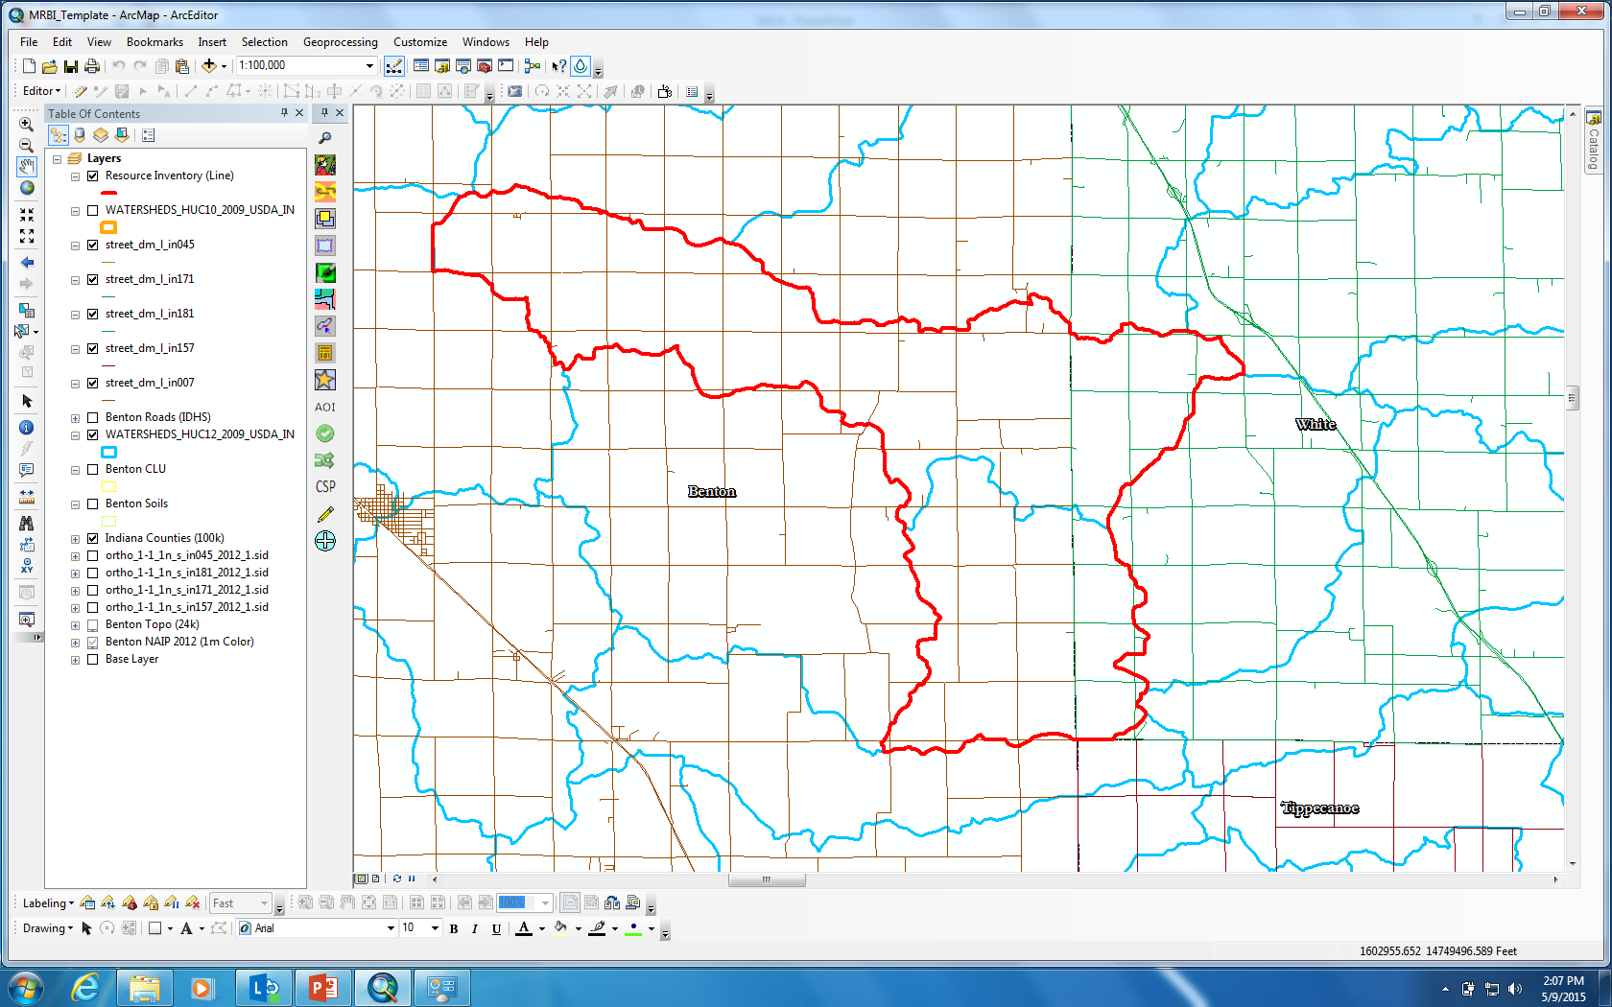

Slide 25
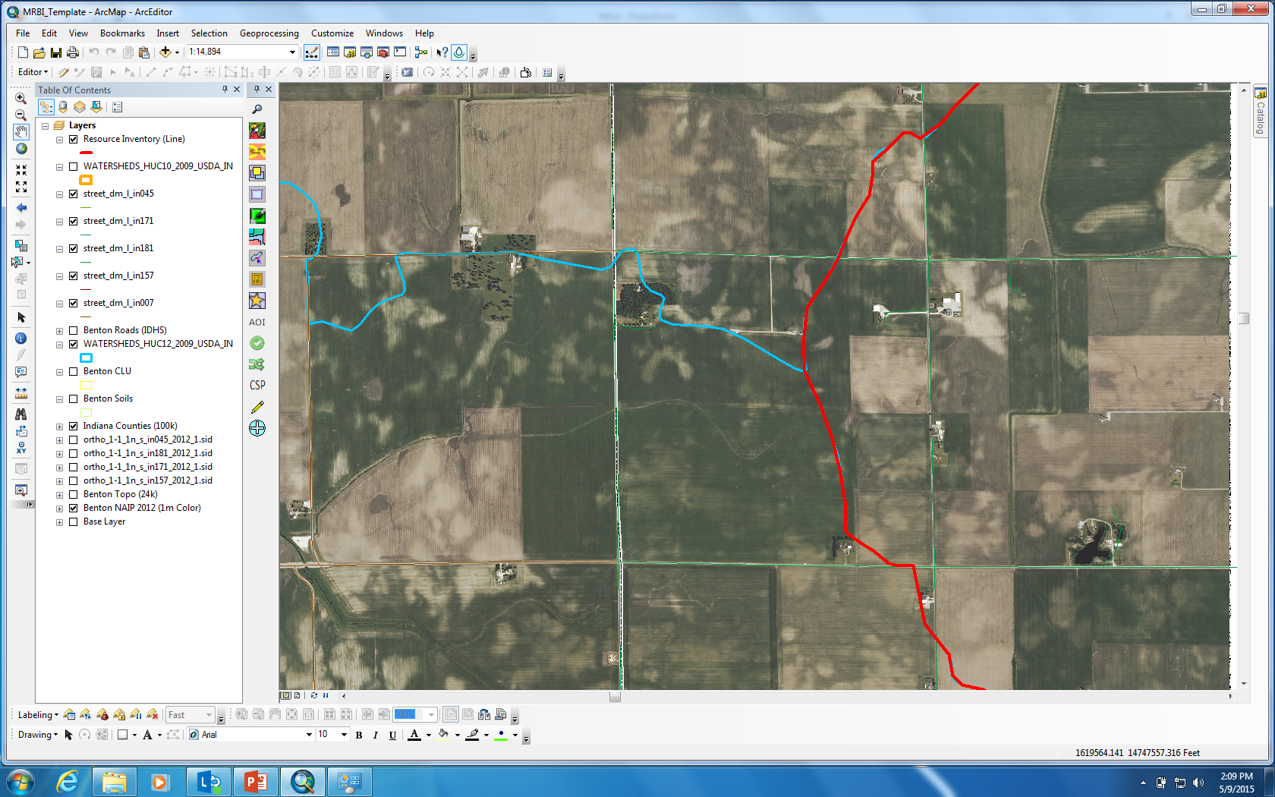

Slide 26
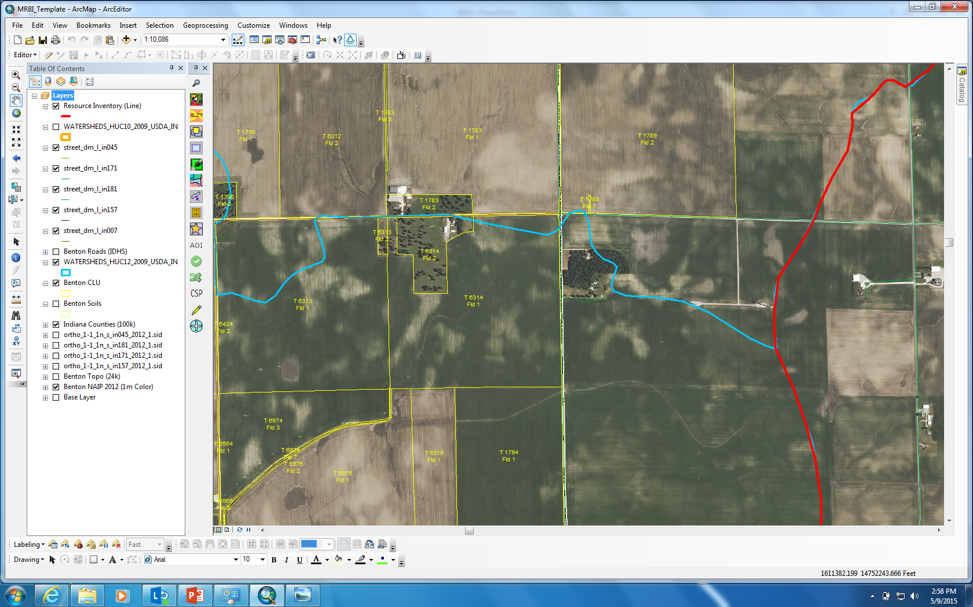

Slide 27
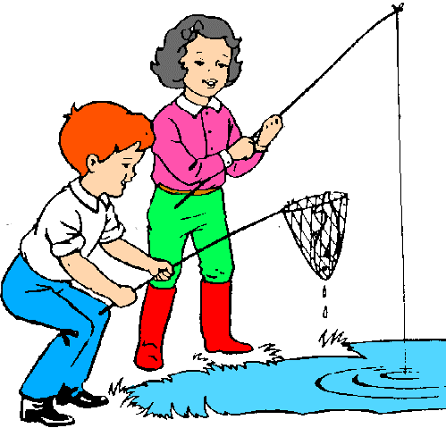
You have delineated your target area.
Using your county CLU layer, you have obtained tract numbers which are useful if you have a relationship with FSA. They will be able to give you the landowner and operator information.

Slide 28
CLU (Common Land Unit), Tract Numbers and associated data are not in the public domain.
This information can only be shared with individuals or organizations certified by FSA as working in cooperation with the Secretary of Agriculture.
Users of the data must be providing assistance to USDA programs and must require access to CLU data to complete that work.
Source: The Internet

Slide 29
Use your county GIS mapping website
Most counties have parcel information online at their GIS websites
If you only have a name, county GIS provides an address using “Property Search” feature
How to access this information can be found by going to IndianaMap.org or by Googling county name, state, and “GIS”
The two most common GIS websites in Indiana are ThinkGIS and Beacon

Slide 31
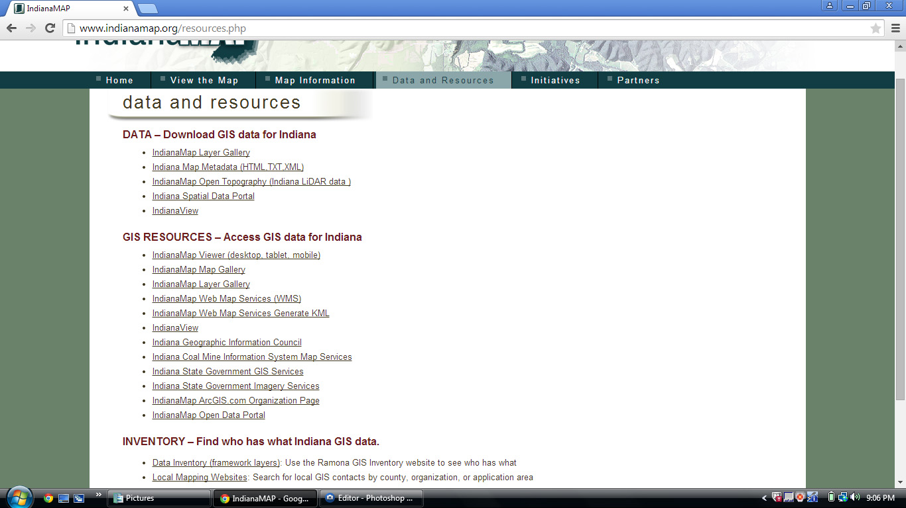

Slide 32
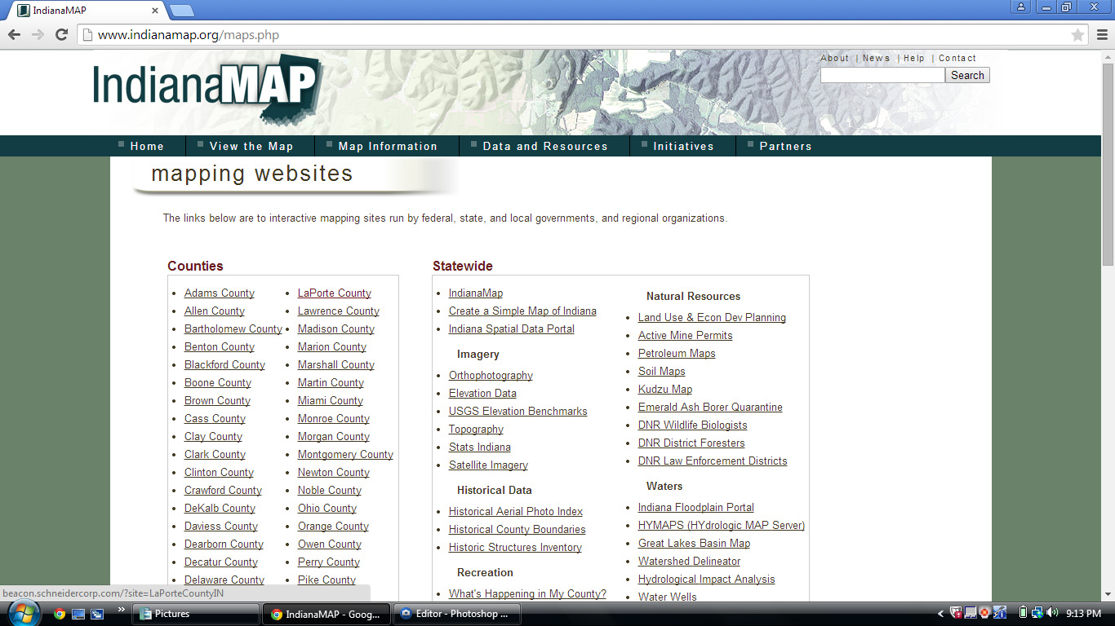

Slide 33
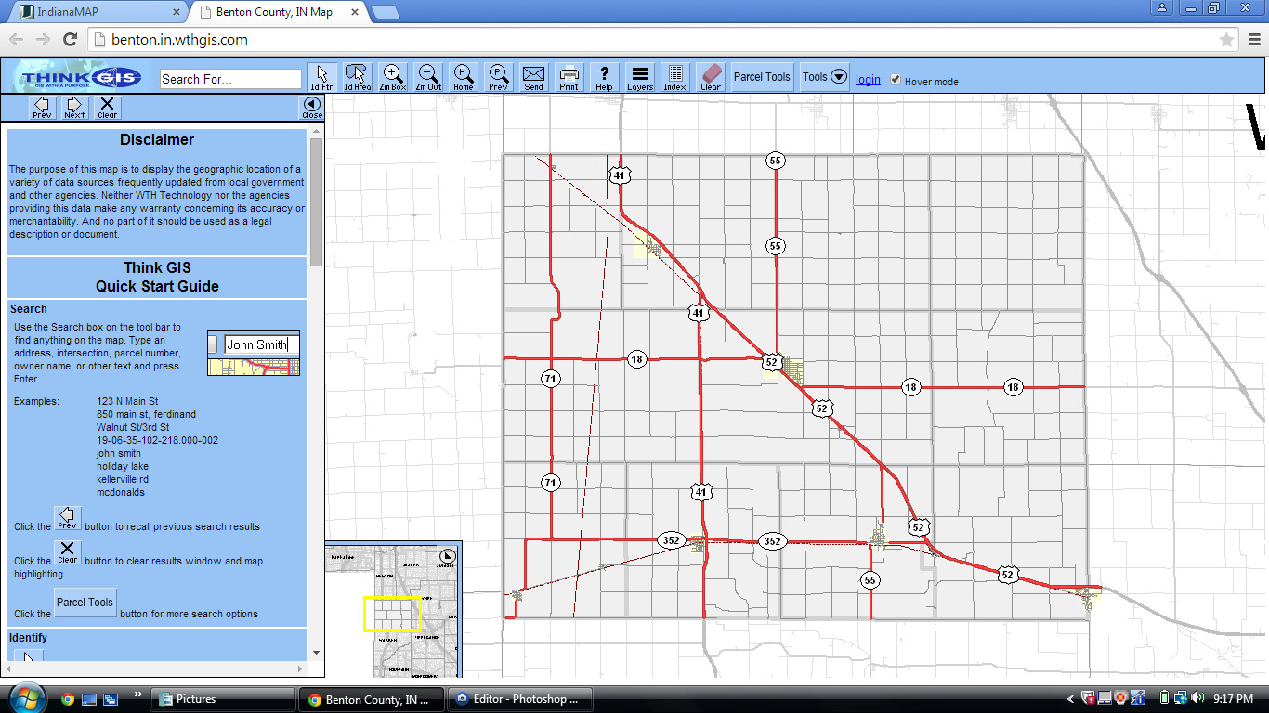

Slide 35
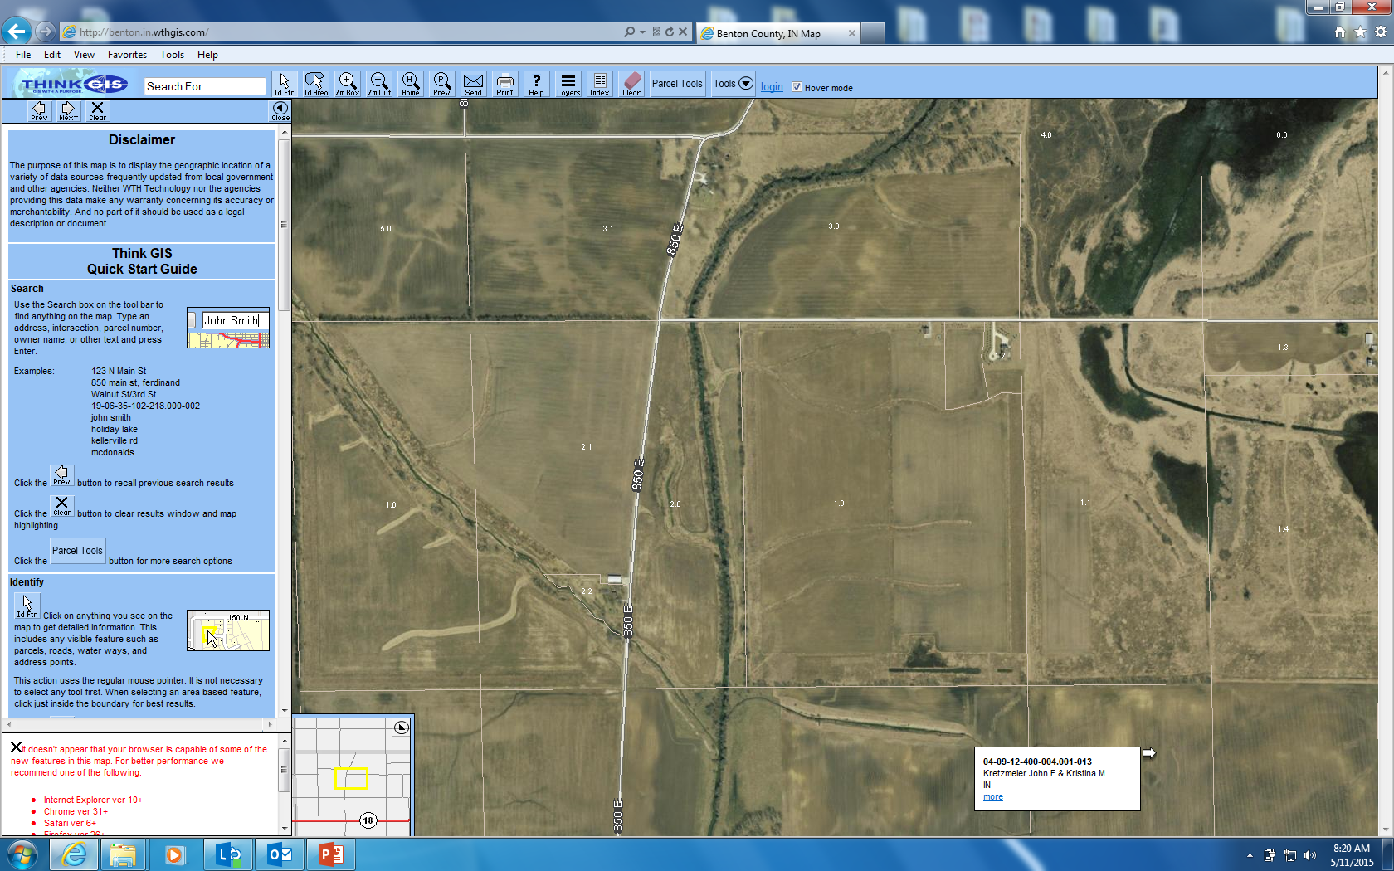

Slide 36
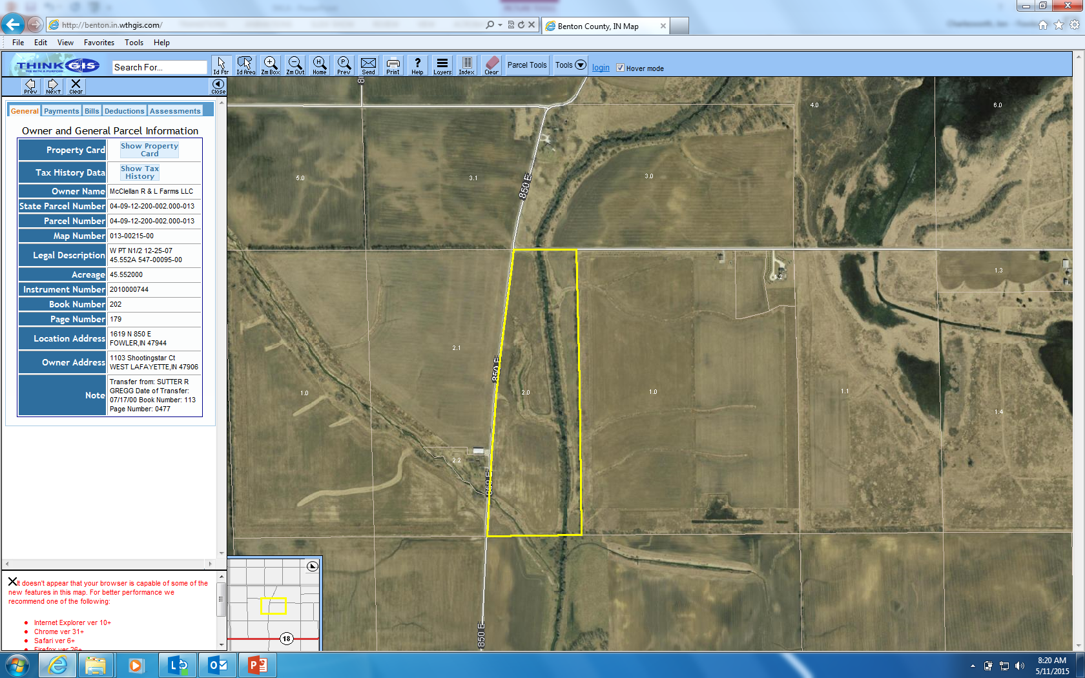

Slide 37
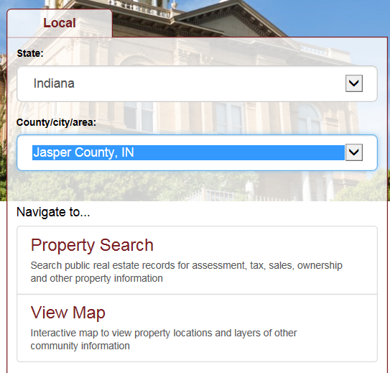
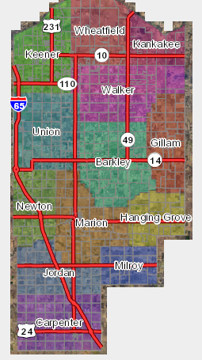
Beacon
Go to www.beaconbeta.schneidercorp.com
Choose your state and county, then “View Map”. A map of your county will appear.
Use the pan and zoom features to narrow down your area.
Note: County GIS will only display one county at a time. If your project area crosses county lines, the process needs to be repeated per county.

Slide 38
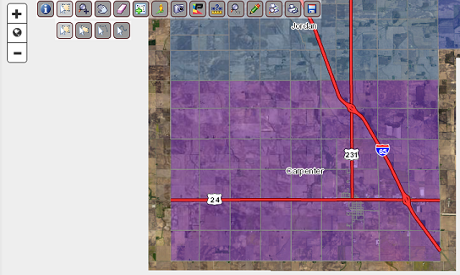
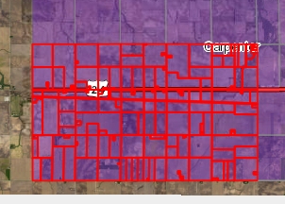
Use the selection tool to select your area. Once you choose the tool, some selection options will appear.
Once you have made your selection, the parcels in your targeted area are outlined in red.

Slide 39
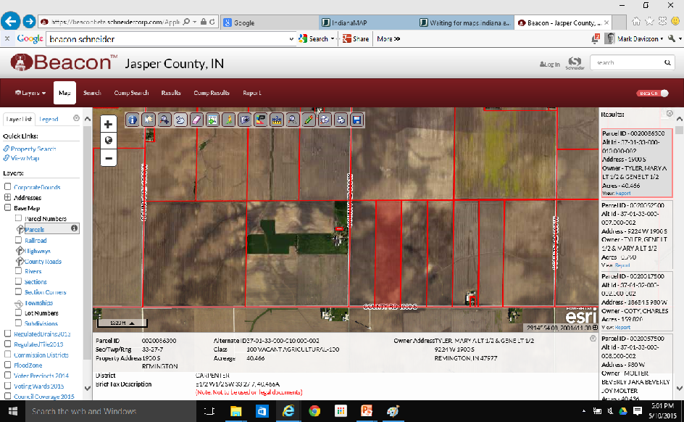
Clicking on a box in the “Results” column on the right side of the screen, highlights that parcel. The “Results” gives you landowner name and address and a link to a full report.

Slide 40
You have landowner addresses, but you need the operators too:
If you are with a government organization that has a MOU with FSA, they can give you a report that will tell you who farms that ground.
If you are not, find someone within your organization who has one or knows someone that has a MOU with FSA.
If neither of these options are available:
Send letters to your landowners informing them of your project.
Get one contact in the area. Show up with a map and ask them who farms the land. Most farmers are very knowledgeable about who is farming around them.
Go “door to door” to meet the people in your project area.

Slide 41
Tips for engaging the landowners and farmers in your project area:
Keep them informed throughout the project via email, phone, social media, texting, local publications, and snail mail.
Create a basic info sheet on the project to leave behind.
Minimize the amount of paperwork and effort on their part.
Small, informal groups of about 10 people are best for peer to peer discussion.
Provide some kind of food or beverage at all meetings.
Be mindful of the social dynamics and neighbor relations in your project area.
Always follow through with your statements and promises-establish trust.

Slide 42
Thank you!!
Leslie Davisson, Asst. Watershed Coordinator
Upper Iroquois River Watershed
Jasper County SWCD
211 E Drexel Pkwy
Rensselaer, IN 47978
219-866-8008 x3
leslie.davisson@in.nacdnet.net
Jon Charlesworth, Watershed Coordinator
Big Pine Creek Watershed
Benton County SWCD
109 S Grant Ave, Suite B
Fowler, IN 47944
765-884-1090 x107
Jon.Charlesworth@in.usda.gov

